Slide 2



Slide 3
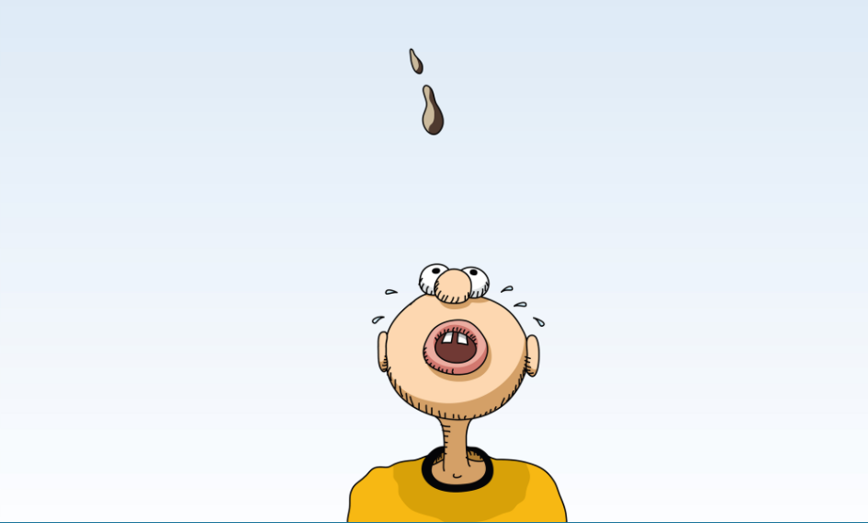

Slide 5
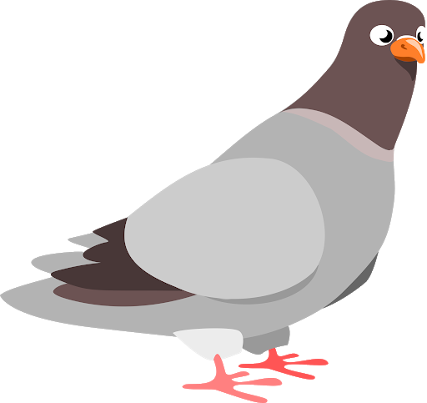
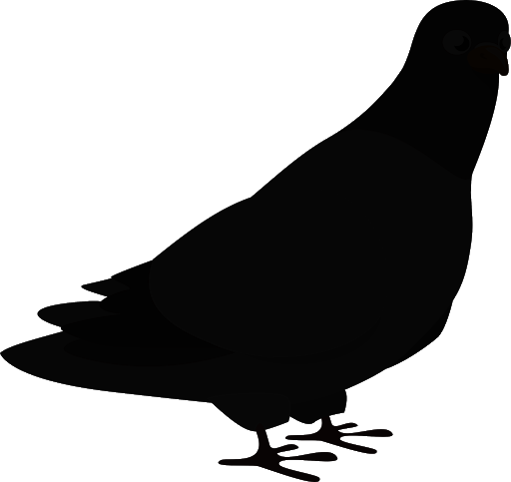
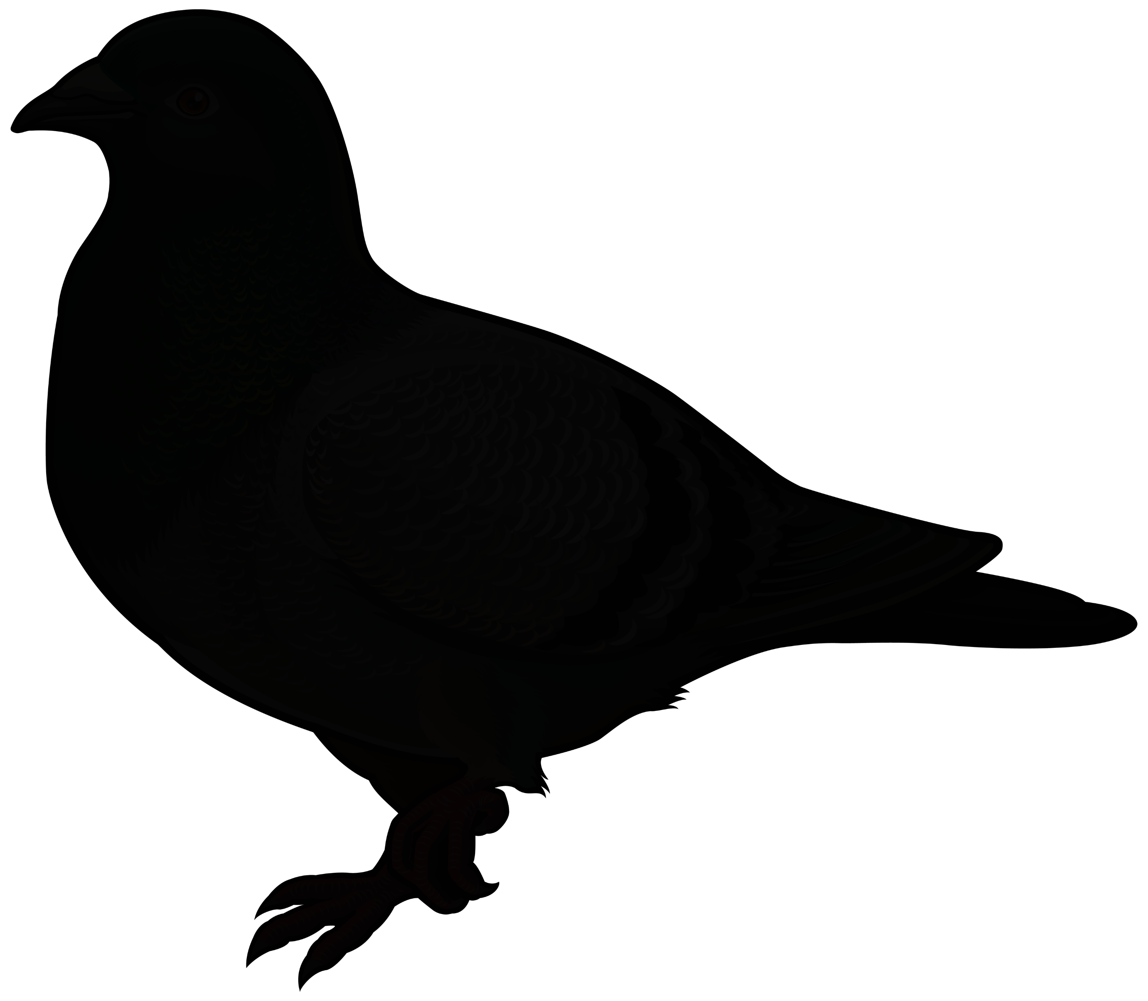
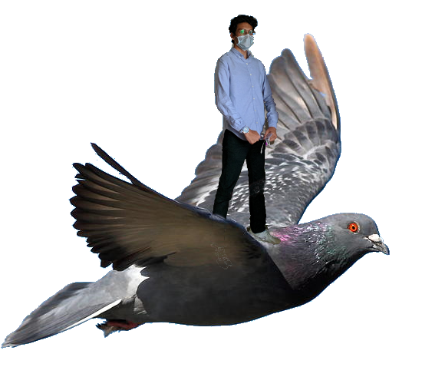
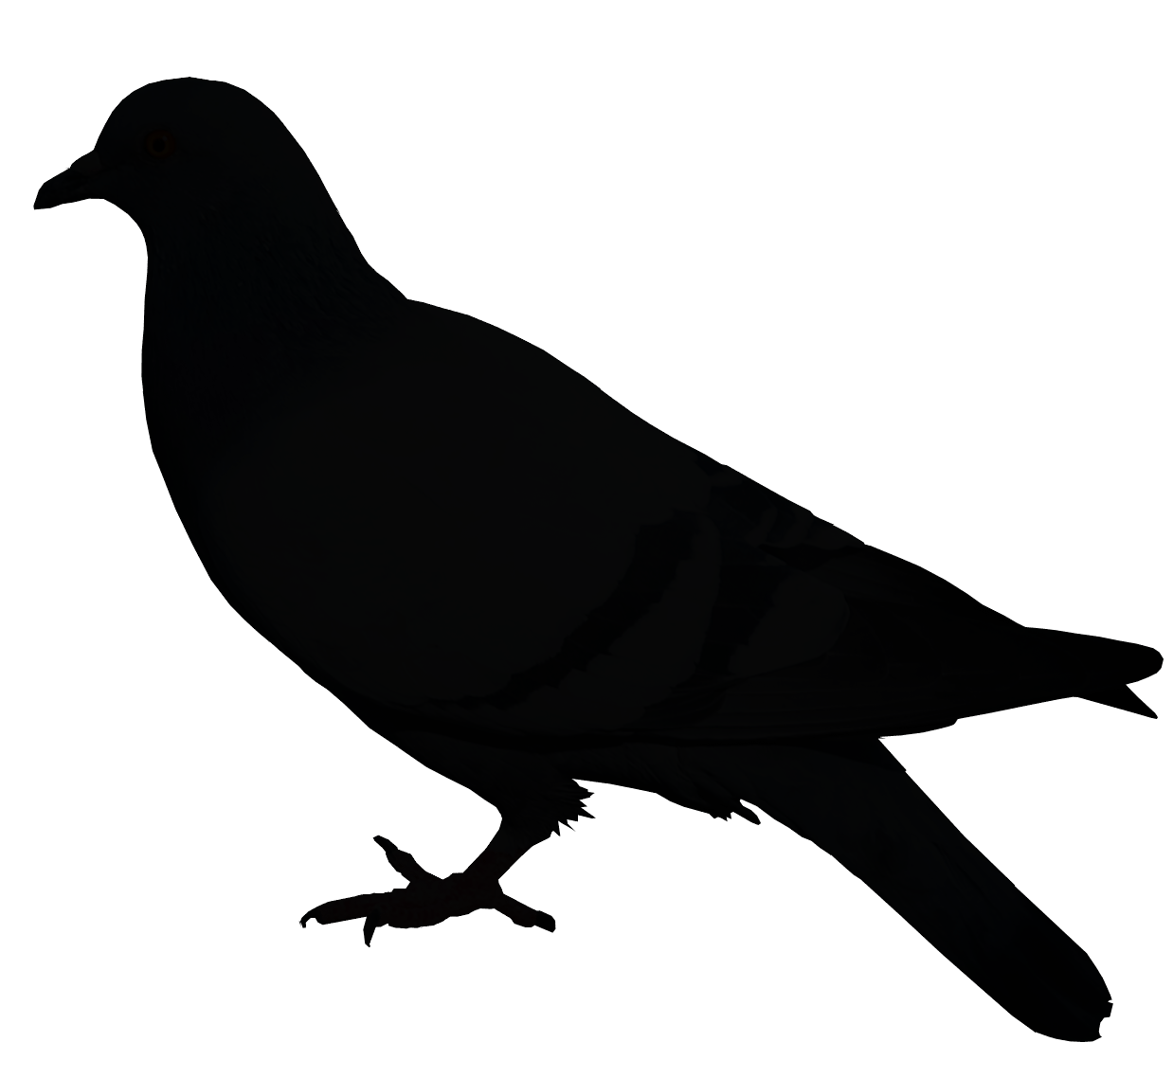
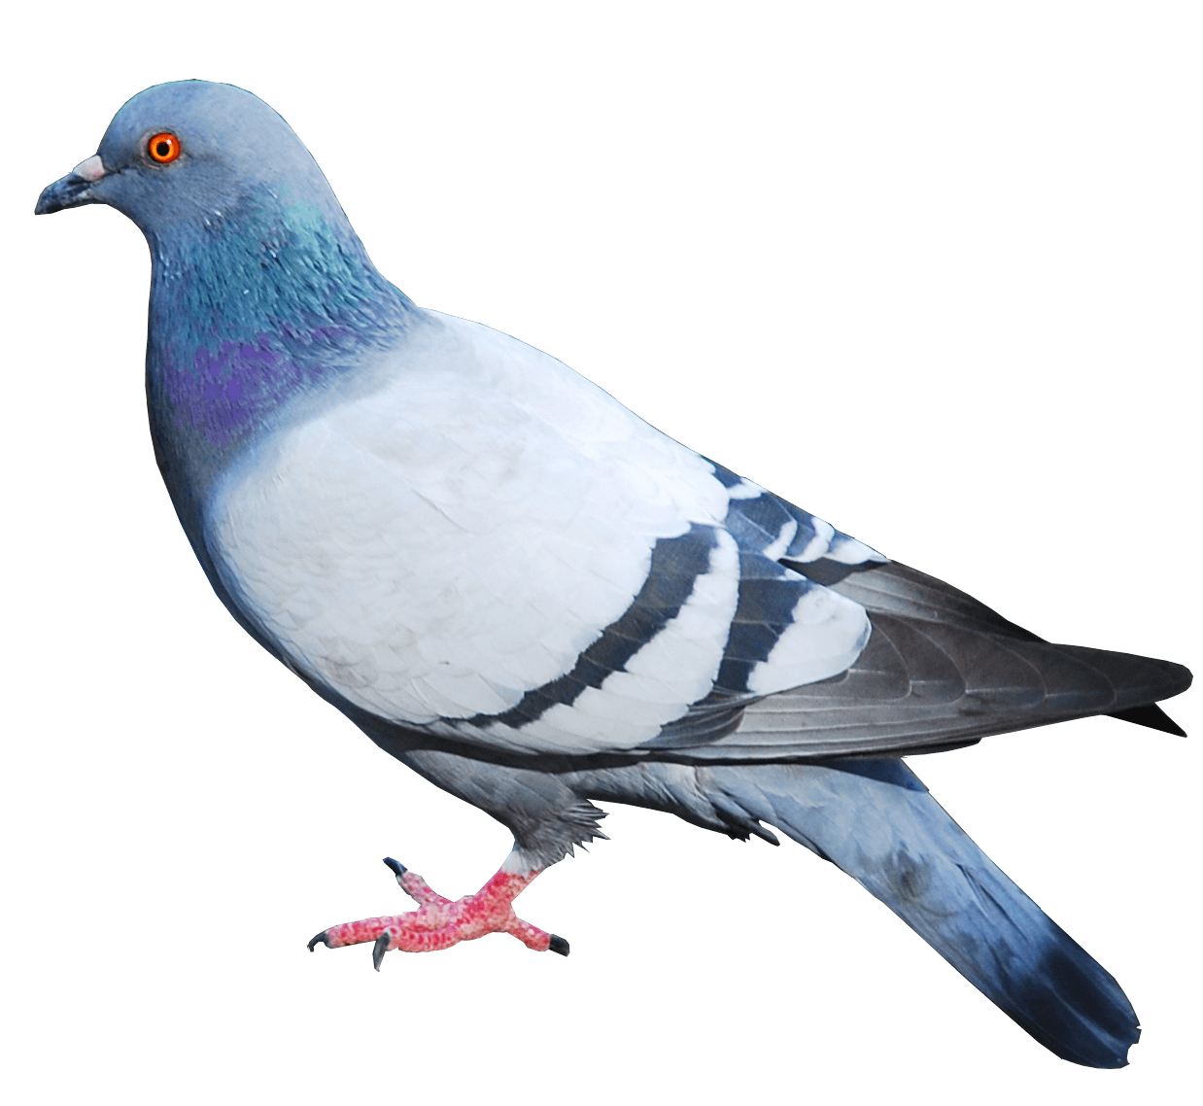
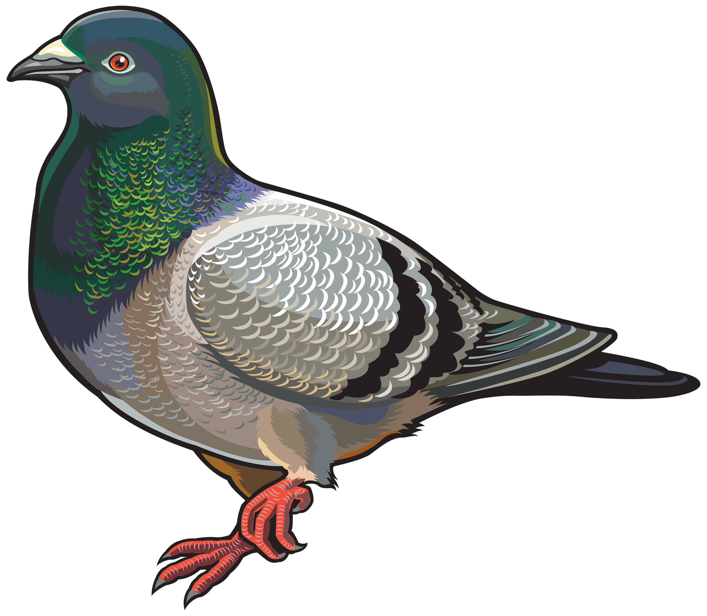

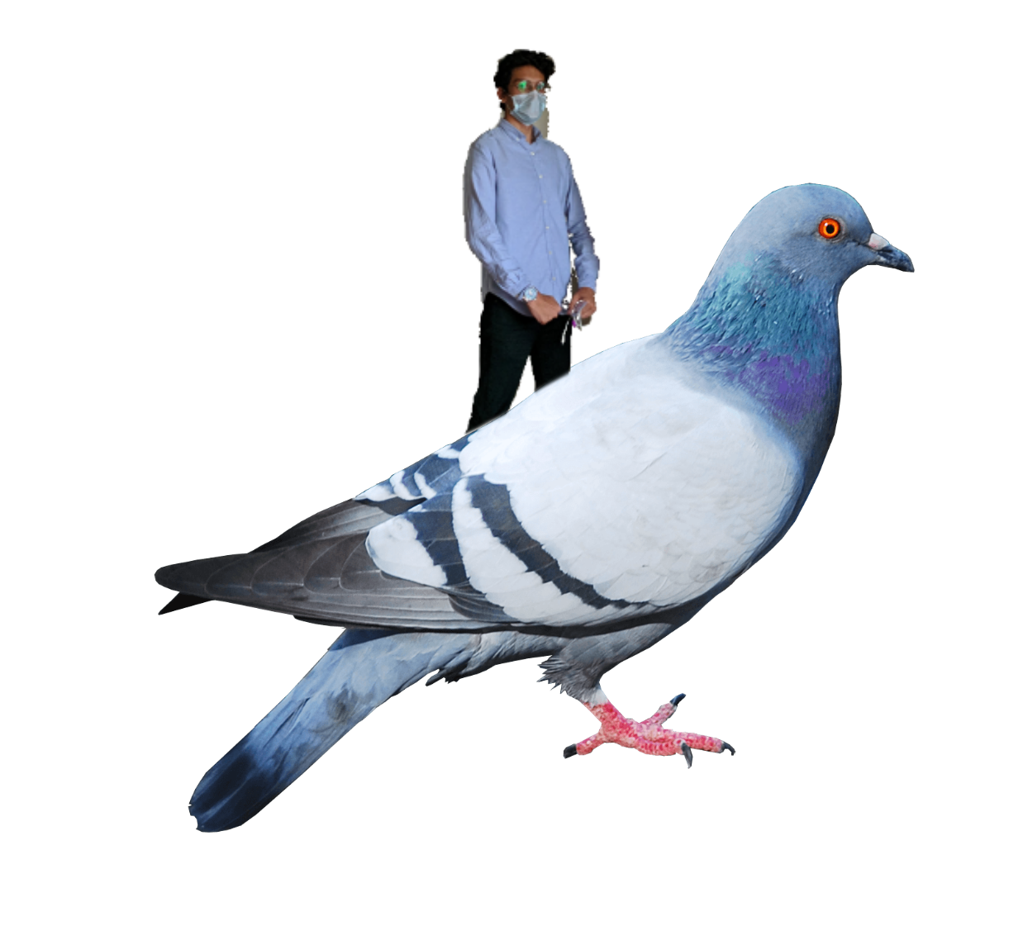



✔
HU SNaKeS & Kabootars
HU SNaKeS & Kabootars
HU Sneks & Kabootars
HU Sneks & Kabootars
HU Sneks & Kabootars
HU Sneks & Kabootars
HU Sneks & Kabootars
HU 🐍 & 🕊
HU Sneks & Kabootars
HU 🐍 & kabootars
HU Sneks & Kabootars
Notes:
Maybe Murtaza the Bird Whisperer is a man of the birds and instead of having the pigeons poop on him and drag him down; they fly him up (i.e. for this character the kabootars = ladders and ladders = ladders – or maybe we say ladders = snakes, because they bring bad luck).

Slide 6

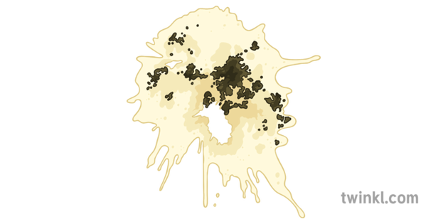
100
70
71
73
1

Slide 7

100
70
71
73
1
2
3
4
5
6
Player X won!
1
Player X’s Turn!
Player X rolled 1
Player X won!

